Slide 1
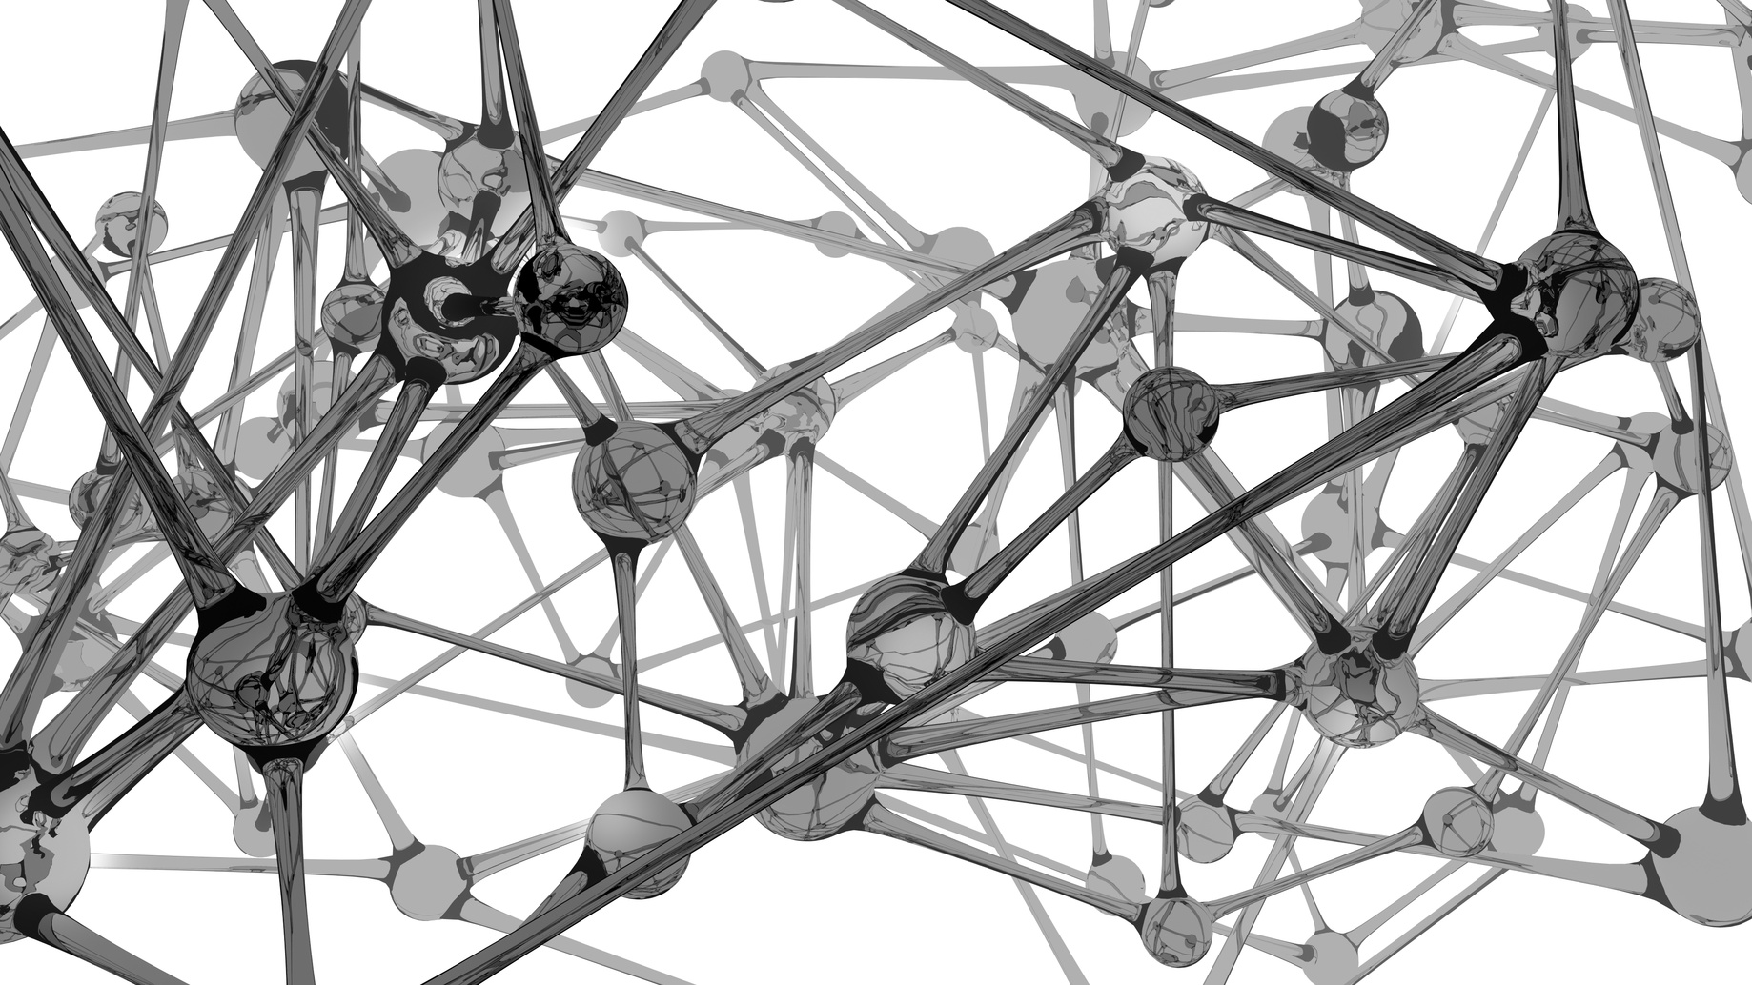
VERY DEEP CONVOLUTIONAL NETWORKS FOR LARGE-SCALE IMAGE RECOGNITION does size matter?
Karen Simonyan
Andrew Zisserman

Slide 2
Contents
Why I Care
Introduction
Convolutional Configuration
Classification
Experiments
Conclusion
Big Picture

Slide 3
Why I care
2nd place in ILSVRC 2014 top-5 val. Challenge

Slide 4
Why I care
2nd place in ILSVRC 2014 top-5 val. Challenge
1st place in ILSVRC 2014 top-1 val. Challenge

Slide 5
Why I care
2nd place in ILSVRC 2014 top-5 val. Challenge
1st place in ILSVRC 2014 top-1 val. Challenge
1st place in ILSVRC 2014 Localization Challenge

Slide 6
Why I care
2nd place in ILSVRC 2014 top-5 val. Challenge
1st place in ILSVRC 2014 top-1 val. Challenge
1st place in ILSVRC 2014 Localization Challenge
Demonstrates architecture that works well on diverse datasets

Slide 7
Why I care
2nd place in ILSVRC 2014 top-5 val. Challenge
1st place in ILSVRC 2014 top-1 val. Challenge
1st place in ILSVRC 2014 Localization Challenge
Demonstrates architecture that works well on diverse datasets
Demonstrates efficient and effective localization and multi-scaling

Slide 8
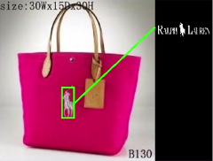
Why I care
First entrepreneurial stint

Slide 9
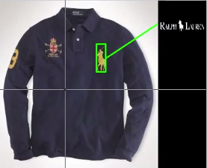
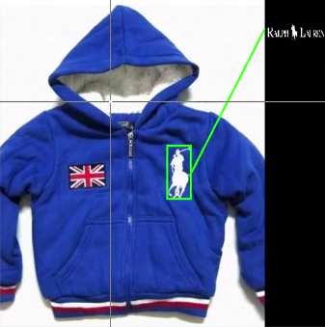
Why I care
First entrepreneurial stint

Slide 10
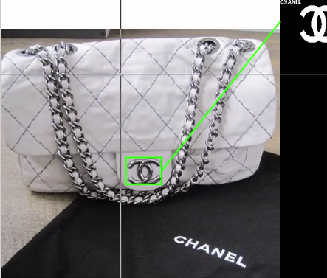
Why I care
First entrepreneurial stint

Slide 11
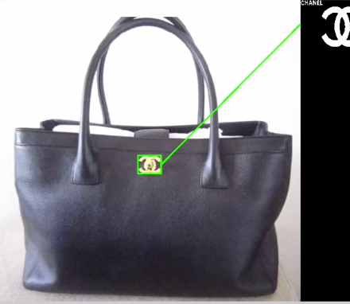
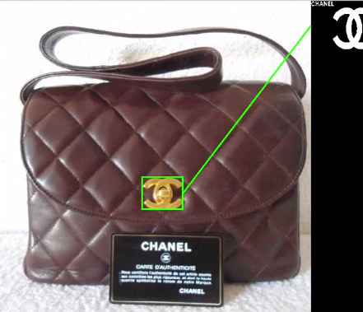
Why I care
First entrepreneurial stint

Slide 12

Why I care
Fraud

Slide 13

Why I care
Fraud

Slide 14
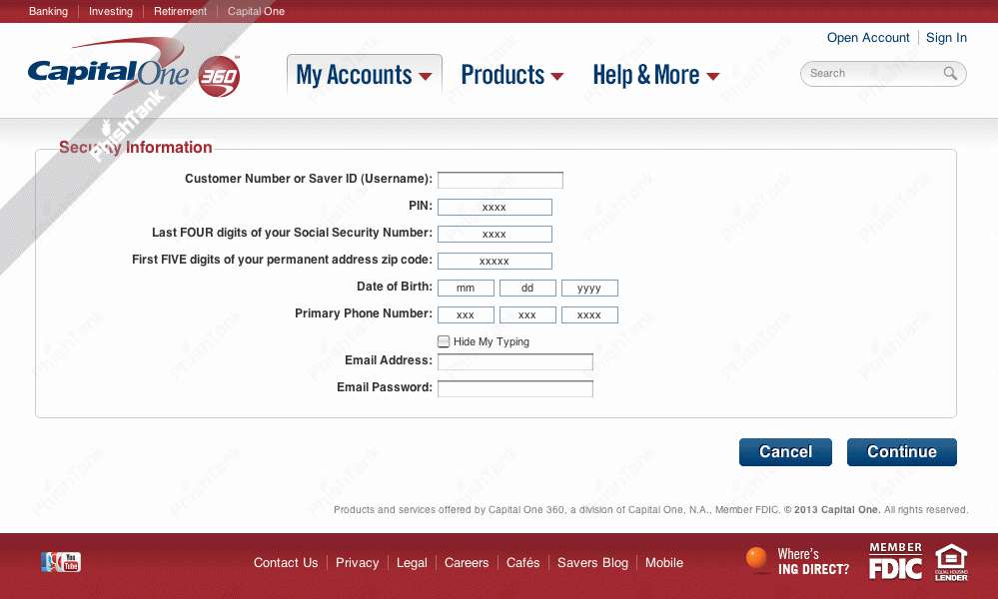
Why I care
Fraud

Slide 15

Why I care
Fraud

Slide 16

Why I care
Fraud

Slide 17

Why I care
Fraud

Slide 18

Why I care
Fraud

Slide 19

Why I care
Fraud

Slide 20

Why I care
Fraud

Slide 21
Introduction
Golden age for CNN’s
Krizhevsky et al. 2012
Establishes new standard

Slide 22
Introduction
Golden age for CNN’s
Krizhevsky et al. 2012
Establishes new standard
Sermanet et al. 2014
‘dense’ application of networks at multiple scales

Slide 23
Introduction
Golden age for CNN’s
Krizhevsky et al. 2012
Establishes new standard
Sermanet et al. 2014
‘dense’ application of networks at multiple scales
Szegedy et al. 2014
Mixes depth with concatenated inceptions and new topologies

Slide 24
Introduction
Golden age for CNN’s
Krizhevsky et al. 2012
Establishes new standard
Sermanet et al. 2014
‘dense’ application of networks at multiple scales
Szegedy et al. 2014
Mixes depth with concatenated inceptions and new topologies
Zeiler & Fergus, 2013
Howard, 2014

Slide 25
Introduction
Key Contributions of Simonyan et al
Systematic evaluation of depth of CNN architecture
Steadily increase the depth of the network by adding more convolutional layers, while holding other parameters fixed
Use very small (3 × 3) convolution filters in all layers

Slide 26
Introduction
Key Contributions of Simonyan et al
Systematic evaluation of depth of CNN architecture
Achieves state of the art accuracy in ILSVRC classification and localization
2nd place in ILSVRC 2014 top-5 val. Challenge
1st place in ILSVRC 2014 top-1 val. Challenge
1st place in ILSVRC 2014 Localization Challenge
Demonstrates architecture that works well on diverse datasets

Slide 27
Introduction
Key Contributions of Simonyan et al
Systematic evaluation of depth of CNN architecture
Achieves state of the art accuracy in ILSVRC classification and localization
Achieves state of the art in Caltech and VOC datasets

Slide 28
Convolutional Configurations
Architecture (I)
Simple image preprocessing: fixed size image inputs (224x224) and mean subtraction

Slide 29
Convolutional Configurations
Architecture (I)
Simple image preprocessing: fixed size image inputs (224x224) and mean subtraction
Stack of small receptive filters (3x3) and (1x1)

Slide 30
Convolutional Configurations
Architecture (I)
Simple image preprocessing: fixed size image inputs (224x224) and mean subtraction
Stack of small receptive filters (3x3) and (1x1)
1 pixel convolutional stride

Slide 31
Convolutional Configurations
Architecture (I)
Simple image preprocessing: fixed size image inputs (224x224) and mean subtraction
Stack of small receptive filters (3x3) and (1x1)
1 pixel convolutional stride
Spatial preserving padding

Slide 32
Convolutional Configurations
Architecture (I)
Simple image preprocessing: fixed size image inputs (224x224) and mean subtraction
Stack of small receptive filters (3x3) and (1x1)
1 pixel convolutional stride
Spatial preserving padding
5 max-pooling layers carried out be 2x2 windows with stride of 2

Slide 33
Convolutional Configurations
Architecture (I)
Simple image preprocessing: fixed size image inputs (224x224) and mean subtraction
Stack of small receptive filters (3x3) and (1x1)
1 pixel convolutional stride
Spatial preserving padding
5 max-pooling layers carried out be 2x2 windows with stride of 2
Max-pooling only applied to some conv layers

Slide 34
Convolutional Configurations
Architecture (II)
A variable stack of Convolutional layers (parameterized by depth)

Slide 35
Convolutional Configurations
Architecture (II)
A variable stack of Convolutional layers (parameterized by depth)
Three Fully Connected (FC) layers (fixed)
First two FC have 4096 channels
Third performs 1000-way ILSVRC classification with 1000 channels

Slide 36
Convolutional Configurations
Architecture (II)
A variable stack of Convolutional layers (parameterized by depth)
Three Fully Connected (FC) layers (fixed)
First two FC have 4096 channels
Third performs 1000-way ILSVRC classification with 1000 channels
Hidden layers use ReLU non-linearity

Slide 37
Convolutional Configurations
Architecture (II)
A variable stack of Convolutional layers (parameterized by depth)
Three Fully Connected (FC) layers (fixed)
First two FC have 4096 channels
Third performs 1000-way ILSVRC classification with 1000 channels
Hidden layers use ReLU non-linearity
Also test Local Response Normalization (LRN) ???

Slide 38
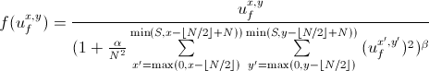
Convolutional Configurations
LRN (???)

Slide 39
Convolutional Configurations
Configurations
11 to 19 weight layers

Slide 40
Convolutional Configurations
Configurations
11 to 19 weight layers
Convolutional layer width increases by factor of 2 after each max-pooling; eg, 64, 128, 512 etc

Slide 41
Convolutional Configurations
Configurations
11 to 19 weight layers
Convolutional layer width increases by factor of 2 after each max-pooling; eg, 64, 128, 512 etc
Key observation: although depth increases, total parameters are loosely conserved compared to shallower CNN’s with larger receptive fields (example all tested nets <= 144M (Sermanet))

Slide 42
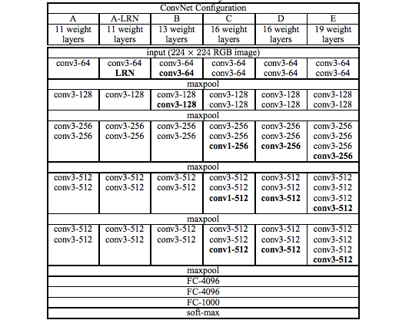
Convolutional Configurations
Configurations

Slide 43

Convolutional Configurations
Configurations

Slide 44
Convolutional Configurations
Remarks
Configurations use stacks of small filters (3x3) and (1x1) with 1 pixel strides

Slide 45
Convolutional Configurations
Remarks
Configurations use stacks of small filters (3x3) and (1x1) with 1 pixel strides
drastic change from larger receptive fields and strides
Eg. 11×11 with stride 4 in (Krizhevsky et al., 2012)
Eg. 7×7 with stride 2 in (Zeiler & Fergus, 2013; Sermanet et al., 2014))

Slide 46
Convolutional Configurations
Remarks
Decreases parameters with same effective receptive field
Consider triple stack of (3x3) filters and a single (7x7) filter
The two have same effective receptive field (7x7)
Single (7x7) has parameters proportional to 49
Triple (3x3) stack has parameters proportional to 3x(3x3) = 27

Slide 47
Convolutional Configurations
Remarks
Decreases parameters with same effective receptive field
Additional conv. Layers add non-linearities introduced by the rectification function

Slide 48
Convolutional Configurations
Remarks
Decreases parameters with same effective receptive field
Additional conv. Layers add non-linearities introduced by the rectification function
Small conv filters also used by Ciresan et al. (2012), and GoogLeNet (Szegedy et al., 2014)

Slide 49
Convolutional Configurations
Remarks
Decreases parameters with same effective receptive field
Additional conv. Layers add non-linearities introduced by the rectification function
Small conv filters also used by Ciresan et al. (2012), and GoogLeNet (Szegedy et al., 2014)
Szegedy also uses VERY deep net (22 weight layers) with complex topology for GoogLeNet

Slide 50
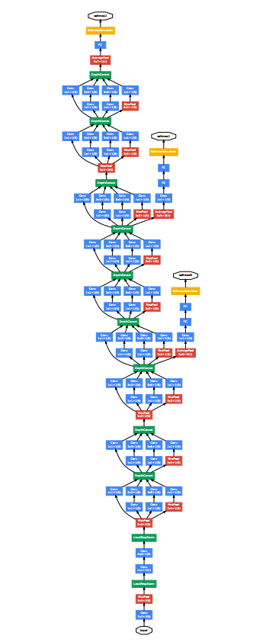
Convolutional Configurations
GoogLeNet… Whaaaaaat ??
Observation: as funding goes to infinity, so does the depth of your CNN

Slide 51
Classification Framework
Training
Generally follows Krizhevsky
Mini-batch gradient descent on multinomial logistic regression with momentum
Batch size: 256
Momentum: 0.9
Weight decay: 5x10⁻⁴
Drop out ratio: 0.5

Slide 52
Classification Framework
Training
Generally follows Krizhevsky
Mini-batch gradient descent on multinomial logistic regression with momentum
370K iterations (74 epochs)
Less than Krizhevsky, even with more parameters
Conjecture
Because greater depth and smaller conv means greater regularisation
Because of pre-initialization

Slide 53
Classification Framework
Training
Generally follows Krizhevsky
Pre-initialization
Start training smallest configuration, shallow enough to be trained with random initialisation.

Slide 54
Classification Framework
Training
Generally follows Krizhevsky
Pre-initialization
Start training smallest configuration, shallow enough to be trained with random initialisation.
When training deeper architectures, initialise the first four convolutional layers and the last three fully-connected layers with smallest configuration layers

Slide 55
Classification Framework
Training
Generally follows Krizhevsky
Pre-initialization
Start training smallest configuration, shallow enough to be trained with random initialisation.
When training deeper architectures, initialise the first four convolutional layers and the last three fully-connected layers with smallest configuration layers
Initialise intermediate weight from normal dist, and biases to zero

Slide 56
Classification Framework
Training
Generally follows Krizhevsky
Pre-initialization
Augmentation and cropping
Each batch, each image is randomly cropped to fit fixed 224x224 input

Slide 57
Classification Framework
Training
Generally follows Krizhevsky
Pre-initialization
Augmentation and cropping
Each batch, each image is randomly cropped to fit fixed 224x224 input
Augmentation via random horizontal flipping and random RGB color shift

Slide 58
Classification Framework
Training
Generally follows Krizhevsky
Pre-initialization
Augmentation and cropping
Training image size
Let S be smallest size of isotropically rescaled image, such that S >= 224

Slide 59
Classification Framework
Training
Generally follows Krizhevsky
Pre-initialization
Augmentation and cropping
Training image size
Let S be smallest size of isotropically rescaled image, such that S >= 224
Approach 1: fixed scale; try both S = 256 and 384

Slide 60
Classification Framework
Training
Generally follows Krizhevsky
Pre-initialization
Augmentation and cropping
Training image size
Let S be smallest size of isotropically rescaled image, such that S >= 224
Approach 1: fixed scale; try both S = 256 and 384
Approach 2: multi-scale training; randomly resample from certain range [256, 512]

Slide 61
Classification Framework
Testing
Network is applied ‘densely’ to whole image, inspired by Sermanet et al 2014
Image is rescaled to Q (not necessarily = S)

Slide 62
Classification Framework
Testing
Network is applied ‘densely’ to whole image, inspired by Sermanet et al 2014
Image is rescaled to Q (not necessarily = S)
The final fully connected layers are converted to convolutional layers (???)

Slide 63
Classification Framework
Testing
Network is applied ‘densely’ to whole image, inspired by Sermanet et al 2014
Image is rescaled to Q (not necessarily = S)
The final fully connected layers are converted to convolutional layers (???)
The resulting fully convolutional net is then applied to whole image, without need for cropping

Slide 64
Classification Framework
Testing
Network is applied ‘densely’ to whole image, inspired by Sermanet et al 2014
Image is rescaled to Q (not necessarily = S)
The final fully connected layers are converted to convolutional layers (???)
The resulting fully convolutional net is then applied to whole image, without need for cropping
Spatial output map is spatially averaged to get fixed vector output

Slide 65
Classification Framework
Testing
Network is applied ‘densely’ to whole image, inspired by Sermanet et al 2014
Image is rescaled to Q (not necessarily = S)
The final fully connected layers are converted to convolutional layers (???)
The resulting fully convolutional net is then applied to whole image, without need for cropping
Spatial output map is spatially averaged to get fixed vector output
Augment test set by horizontal flipping

Slide 66
Classification Framework
Testing
Network is applied ‘densely’ to whole image
Remarks
Dense application works on whole image

Slide 67
Classification Framework
Testing
Network is applied ‘densely’ to whole image
Remarks
Dense application works on whole image
Krizhevsky 2012 and Szegedy 2014 uses multiple crops at test time

Slide 68
Classification Framework
Testing
Network is applied ‘densely’ to whole image
Remarks
Dense application works on whole image
Krizhevsky 2012 and Szegedy 2014 uses multiple crops at test time
Two approaches have accuracy-time tradeoff

Slide 69
Classification Framework
Testing
Network is applied ‘densely’ to whole image
Remarks
Dense application works on whole image
Krizhevsky 2012 and Szegedy 2014 uses multiple crops at test time
Two approaches have accuracy-time tradeoff
They can be implemented complementarily; only change is that features have different padding

Slide 70
Classification Framework
Testing
Network is applied ‘densely’ to whole image
Remarks
Dense application works on whole image
Krizhevsky 2012 and Szegedy 2014 uses multiple crops at test time
Two approaches have accuracy-time tradeoff
They can be implemented complementarily; only change is that features have different padding
Also test using 50 crops /scale

Slide 71
Classification Framework
Implementation
Derived from public C++ Caffe toolbox (Jia, 2013)
Modified to train and evaluate on multiple GPU’s
Designed for uncropped images at multiple scales
Optimized around batch parallelism
Synchoronous gradient computation
3.75 x speedup compared to single GPU
2-3 weeks training

Slide 72
Experiments
Data, ILSVRC-2012 dataset
1000 classes
1.3 M training images
50 K validation images
100 K testing images
Two performance metrics
Top-1 error
Top-5 error

Slide 73
Experiments
Single-Scale Evaluation
Q = S for fixed S

Slide 74
Experiments
Single-Scale Evalutation
Q = S for fixed S
Q = 0.5(Smin + Smax) for jittered S ∈ [Smin, Smax]

Slide 75
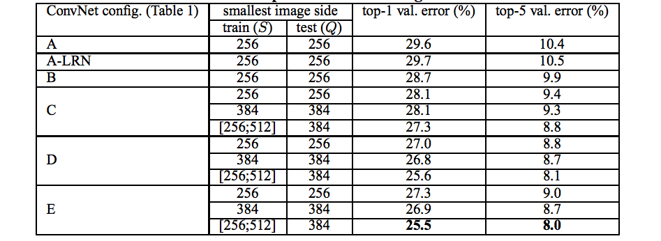
Experiments
Single-Scale Evalutation
ConvNet Performance

Slide 76
Experiments
Single-Scale Evalutation
Remarks
Local Response Normalization doesn’t help

Slide 77
Experiments
Single-Scale Evalutation
Remarks
Performance clearly favors depth (size matters!)

Slide 78
Experiments
Single-Scale Evalutation
Remarks
Prefers (3x3) to (1x1) filters

Slide 79
Experiments
Single-Scale Evalutation
Remarks
Scale jittering at training helps performance

Slide 80
Experiments
Single-Scale Evalutation
Remarks
Performance starts to saturate with depth

Slide 81
Experiments
Multi-Scale Evaluation
Run model over several rescaled versions, or Q-values, and average resulting posteriors

Slide 82
Experiments
Multi-Scale Evaluation
Run model over several rescaled versions, or Q-values, and average resulting posteriors
For fixed S, Q = {S − 32, S, S + 32}

Slide 83
Experiments
Multi-Scale Evaluation
Run model over several rescaled versions, or Q-values, and average resulting posteriors
For fixed S, Q = {S − 32, S, S + 32}
For jittered S, S ∈ [Smin; Smax], Q = {Smin, 0.5(Smin + Smax), Smax}

Slide 84
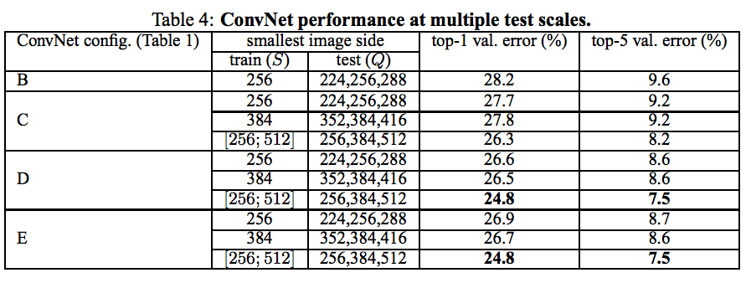
Experiments
Multi-Scale Evaluation

Slide 85
Experiments
Multi-Scale Evaluation
Remark: same pattern (1) preference towards depth, (2) Prefer training jittering

Slide 86
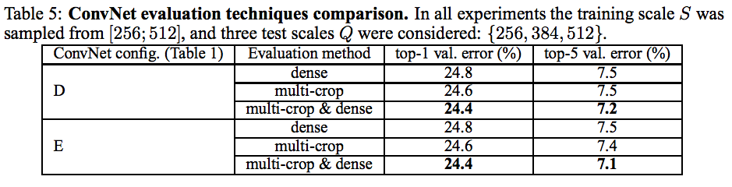
Experiments
Multi-Crop Evaluation
Evaluate multi-crop performance

Slide 87
Experiments
Multi-Crop Evaluation
Evaluate multi-crop performance
Remark: does slightly better than dense

Slide 88
Experiments
Multi-Crop Evaluation
Evaluate multi-crop performance
Remark: best result is averaging both posteriors

Slide 89
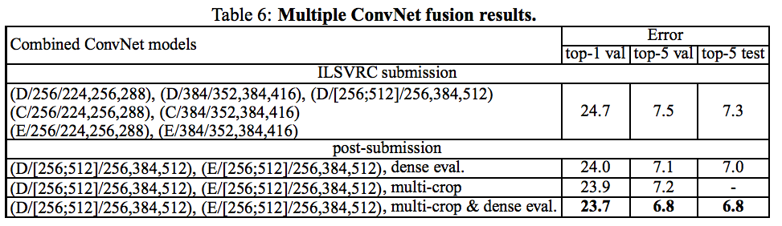
Experiments
Conv Net Fusion
Average softmax class posteriors
Only got multi-crop results after submission

Slide 90
Experiments
Conv Net Fusion
Average softmax class posteriors
Remark: 2-net post submission better than 7-net

Slide 91
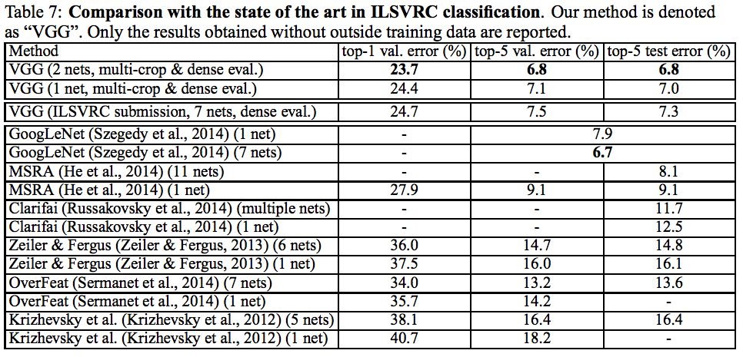
Experiments
ILSVRC-2014 Challenge
7-net submission got 2nd place classification

Slide 92
Experiments
ILSVRC-2014 Challenge
2-net post-submission even better!

Slide 93
Experiments
ILSVRC-2014 Challenge
1st place, Szegedy, uses 7-nets

Slide 94
Localization
Inspired by Sermanet et al
Special case of object detection

Slide 95
Localization
Inspired by Sermanet et al
Special case of object detection
Predicts single object bounding box for each of the top-5 classes, irrespective of the actual number of objects of the class

Slide 96
Localization
Method
Architecture
Same very deep architecture (D)
Includes 4-D bounding box prediction

Slide 97
Localization
Method
Architecture
Same very deep architecture (D)
Includes 4-D bounding box prediction
Two cases
Single-class regression (SCR); last layer is 4-D
Per-class regression (PCR); last layer is 4000-D

Slide 98
Localization
Method
Architecture
Training
Replace logistic regression objective with Euclidean loss based on bounding box prediction from ground truth

Slide 99
Localization
Method
Architecture
Training
Replace logistic regression objective with Euclidean loss based on bounding box prediction from ground truth
Only trained on fixed size S = 256 and 384

Slide 100
Localization
Method
Architecture
Training
Replace logistic regression objective with Euclidean loss based on bounding box prediction from ground truth
Only trained on fixed size S = 256 and 384
Initialized the same way as classification model

Slide 101
Localization
Method
Architecture
Training
Replace logistic regression objective with Euclidean loss based on bounding box prediction from ground truth
Only trained on fixed size S = 256 and 384
Initialized the same way as classification model
Tried fine-tuning (???) all layers and only first 2 FC layers

Slide 102
Localization
Method
Architecture
Training
Replace logistic regression objective with Euclidean loss based on bounding box prediction from ground truth
Only trained on fixed size S = 256 and 384
Initialized the same way as classification model
Tried fine-tuning (???) all layers and only first 2 FC layers
Last FC layer was initialized and trained from scratch

Slide 103
Localization
Method
Testing
Ground truth
Only considers bounding boxes for ground truth class

Slide 104
Localization
Method
Testing
Ground truth
Only considers bounding boxes for ground truth class
Applies network only to central image crop

Slide 105
Localization
Method
Testing
Ground truth
Only considers bounding boxes for ground truth class
Applies network only to central image crop
Fully-fledged
Dense application to entire image

Slide 106
Localization
Method
Testing
Ground truth
Only considers bounding boxes for ground truth class
Applies network only to central image crop
Fully-fledged
Dense application to entire image
Last fully connected layer is a a set of bounding boxes

Slide 107
Localization
Method
Testing
Ground truth
Only considers bounding boxes for ground truth class
Applies network only to central image crop
Fully-fledged
Dense application to entire image
Last fully connected layer is a a set of bounding boxes
Use greedy merging procedure to merge close predictions

Slide 108
Localization
Method
Testing
Ground truth
Only considers bounding boxes for ground truth class
Applies network only to central image crop
Fully-fledged
Dense application to entire image
Last fully connected layer is a a set of bounding boxes
Use greedy merging procedure to merge close predictions
After merging, uses class scores

Slide 109
Localization
Method
Testing
Ground truth
Only considers bounding boxes for ground truth class
Applies network only to central image crop
Fully-fledged
Dense application to entire image
Last fully connected layer is a a set of bounding boxes
Use greedy merging procedure to merge close predictions
After merging, uses class scores
For ConvNet combinations, it takes unions of box predictions

Slide 110
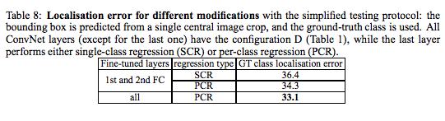
Localization
Experiment
Settings Experiment (SCR v PCR)
Tested using considers central crop & ground truth protocol

Slide 111
Localization
Experiment
Settings Experiment (SCR v PCR)
Remark (1): PCR does better than SCR
In other words, class specific localization is preferred

Slide 112
Localization
Experiment
Settings Experiment (SCR v PCR)
Remark (2): fine-tuning all layers is preferred to just fine tuning 1st and 2nd FC layers

Slide 113
Localization
Experiment
Settings Experiment (SCR v PCR)
(1) counter to Sermanet et al’s findings
(2) Sermanet only fine tuned 1st and 2nd layer

Slide 114
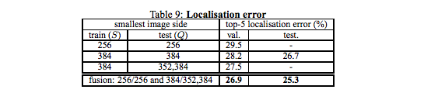
Localization
Experiment
Fully Fledged experiment (PCR + fine tuning ALL FC’s)
Recap: full-convolutional classification on whole image
Recap: merges predictions using Sermanet method

Slide 115
Localization
Experiment
Fully Fledged experiment (PCR + fine tuning ALL FC’s)
Substantially better performance than central crop!

Slide 116
Localization
Experiment
Fully Fledged experiment (PCR + fine tuning ALL FC’s)
Substantially better performance than central crop!
Again confirms fusion gets better results

Slide 117
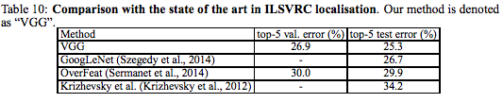
Localization
Experiment
Comparison with State of the Art
Wins localization challenge for ILSVRC 2014, 25.3%

Slide 118
Localization
Experiment
Comparison with State of the Art
Wins localization challenge for ILSVRC 2014, 25.3%
Beats Sermanet’s OverFeat without multiple scales and resolution enhancement

Slide 119
Localization
Experiment
Comparison with State of the Art
Wins localization challenge for ILSVRC 2014, 25.3%
Beats Sermanet’s OverFeat without multiple scales and resolution enhancement
Suggests very deep ConvNets have stronger representation

Slide 120
Generalization of Very Deep Features
Demand for application on smaller datasets
ILSVRC derived ConvNet feature extractors have outperformed hand-crafted representations by a large margin

Slide 121
Generalization of Very Deep Features
Demand for application on smaller datasets
ILSVRC derived ConvNet feature extractors have outperformed hand-crafted representations by a large margin
Approach for smaller datasets
Remove last 1000-D fully connected layer

Slide 122
Generalization of Very Deep Features
Demand for application on smaller datasets
ILSVRC derived ConvNet feature extractors have outperformed hand-crafted representations by a large margin
Approach for smaller datasets
Remove last 1000-D fully connected layer
Use penultimate 4096-D layer as input to SVM

Slide 123
Generalization of Very Deep Features
Demand for application on smaller datasets
ILSVRC derived ConvNet feature extractors have outperformed hand-crafted representations by a large margin
Approach for smaller datasets
Remove last 1000-D fully connected layer
Use penultimate 4096-D layer as input to SVM
Train SVM on smaller dataset

Slide 124
Generalization of Very Deep Features
Demand for application on smaller datasets
Evaluation is similar to regular dense application
Rescale to Q
apply network densely over whole image
Global average pooling on resulting 4096-D descriptor
Horizontal flipping

Slide 125
Generalization of Very Deep Features
Demand for application on smaller datasets
Evaluation is similar to regular dense application
Rescale to Q
apply network densely over whole image
Global average pooling on resulting 4096-D descriptor
Horizontal flipping
Pooling over multiple scales
Other approaches stack descriptors of different scales
Results in increasing dimensionality of descriptor

Slide 126
Generalization of Very Deep Features
Demand for application on smaller datasets
Application 1: VOC-2007 and 2012
Specifications
10K and 22.5K images respectively
One to several labels per image
20 object categories

Slide 127
Generalization of Very Deep Features
Demand for application on smaller datasets
Application 1: VOC-2007 and 2012
Observations
Averaging different scales works as well as stacking image descriptors
Does not inflate descriptor dimensionality

Slide 128
Generalization of Very Deep Features
Demand for application on smaller datasets
Application 1: VOC-2007 and 2012
Observations
Averaging different scales works as well as stacking image descriptors
Does not inflate descriptor dimensionality
Allows aggregation over a wide range of scales, Q ∈ {256, 384, 512, 640, 768}

Slide 129
Generalization of Very Deep Features
Demand for application on smaller datasets
Application 1: VOC-2007 and 2012
Observations
Averaging different scales works as well as stacking image descriptors
Does not inflate descriptor dimensionality
Allows aggregation over a wide range of scales, Q ∈ {256, 384, 512, 640, 768}
Only small improvement (0.3%) over a smaller range of {256, 384, 512}

Slide 130
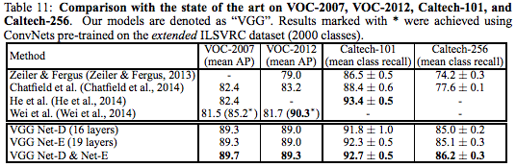
Generalization of Very Deep Features
Demand for application on smaller datasets
Application 1: VOC-2007 and 2012
New performance benchmark in both ’07 & ‘12!

Slide 131
Generalization of Very Deep Features
Demand for application on smaller datasets
Application 1: VOC-2007 and 2012
Remarks: D and E have same performance

Slide 132
Generalization of Very Deep Features
Demand for application on smaller datasets
Application 1: VOC-2007 and 2012
Remarks: best performance is D & E hybrid

Slide 133
Generalization of Very Deep Features
Demand for application on smaller datasets
Application 1: VOC-2007 and 2012
Remarks: Wei et al 2012 result has extra training

Slide 134
Generalization of Very Deep Features
Demand for application on smaller datasets
Application 2: Caltech-101 ‘04 and 256 ‘07
Specifications
Caltech 101
9K Images
102 classes (101 object classes + background class)
Caltech 256
31K images
257 classes
Generate random splits for train/test data

Slide 135
Generalization of Very Deep Features
Demand for application on smaller datasets
Application 2: Caltech-101 ‘04 and 256 ‘07
Observations
Stacking descriptors did better than average pooling

Slide 136
Generalization of Very Deep Features
Demand for application on smaller datasets
Application 2: Caltech-101 ‘04 and 256 ‘07
Observations
Stacking descriptors did better than average pooling
Different outcome from VOC case

Slide 137
Generalization of Very Deep Features
Demand for application on smaller datasets
Application 2: Caltech-101 ‘04 and 256 ‘07
Observations
Stacking descriptors did better than average pooling
Different outcome from VOC case
Caltech objects typically occupy whole image

Slide 138
Generalization of Very Deep Features
Demand for application on smaller datasets
Application 2: Caltech-101 ‘04 and 256 ‘07
Observations
Stacking descriptors did better than average pooling
Different outcome from VOC case
Caltech objects typically occupy whole image
Multi-scale descriptors, ie. stacking, capture scale specific representations

Slide 139
Generalization of Very Deep Features
Demand for application on smaller datasets
Application 2: Caltech-101 ‘04 and 256 ‘07
Observations
Stacking descriptors did better than average pooling
Different outcome from VOC case
Caltech objects typically occupy whole image
Multi-scale descriptors, ie. stacking, capture scale specific representations
Three scales Q ∈ {256, 384, 512}

Slide 140
Generalization of Very Deep Features
Demand for application on smaller datasets
Application 2: Caltech-101 ‘04 and 256 ‘07
New performance benchmark in 256 ’07,
Competitive with 101 ’04 benchmark

Slide 141
Generalization of Very Deep Features
Demand for application on smaller datasets
Application 2: Caltech-101 ‘04 and 256 ‘07
Remark: E a little better than D
Remark: Hybrid (E&D) is best as usual

Slide 142
Generalization of Very Deep Features
Demand for application on smaller datasets
Other Recognition Tasks
Active demand for a wide range of image recognition tasks, consistently outperforming more shallow representations.
Object detection (Girshick et al. 2014)

Slide 143
Generalization of Very Deep Features
Demand for application on smaller datasets
Other Recognition Tasks
Active demand for a wide range of image recognition tasks, consistently outperforming more shallow representations.
Object detection (Girshick et al. 2014)
Semantic segmentation (Long et al., 2014),

Slide 144
Generalization of Very Deep Features
Demand for application on smaller datasets
Other Recognition Tasks
Active demand for a wide range of image recognition tasks, consistently outperforming more shallow representations.
Object detection (Girshick et al. 2014)
Semantic segmentation (Long et al., 2014),
Image caption generation (Kiros et al., 2014; Karpathy & Fei-Fei, 2014)

Slide 145
Generalization of Very Deep Features
Demand for application on smaller datasets
Other Recognition Tasks
Active demand for a wide range of image recognition tasks, consistently outperforming more shallow representations.
Object detection (Girshick et al. 2014)
Semantic segmentation (Long et al., 2014),
Image caption generation (Kiros et al., 2014; Karpathy & Fei-Fei, 2014)
Texture and material recognition (Cimpoi et al., 2014; Bell et al., 2014).

Slide 146
Conclusion
Demonstrated depth increase benefits performance accuracy (size matters!)

Slide 147
Conclusion
Demonstrated depth increase benefits performance accuracy (size matters!)
Achieves 2nd place in ILSVRC 2014 Challenge
Achieves 2nd place in top-5 val error (7.5%)
Achieves 1st place in top-1 val error (24.7%)

Slide 148
Conclusion
Demonstrated depth increase benefits performance accuracy (size matters!)
Achieves 2nd place in ILSVRC 2014 Challenge
Achieves 2nd place in top-5 val error (7.5%)
Achieves 1st place in top-1 val error (24.7%)
7.0% & 11.2% better than prior winners

Slide 149
Conclusion
Demonstrated depth increase benefits performance accuracy (size matters!)
Achieves 2nd place in ILSVRC 2014 Challenge
Achieves 2nd place in top-5 val error (7.5%)
Achieves 1st place in top-1 val error (24.7%)
7.0% & 11.2% better than prior winners
Post submission got 6.8% with only 2-nets
Szegedy got 1st 6.7% with 7-nets

Slide 150
Conclusion
Demonstrated depth increase benefits performance accuracy (size matters!)
Achieves 2nd place in ILSVRC 2014 Challenge
Achieves 1st place state of the art for localization Challenge
25.3% test error

Slide 151
Conclusion
Demonstrated depth increase benefits performance accuracy (size matters!)
Achieves 2nd place in ILSVRC 2014 Challenge
Achieves 1st place state of the art for localization Challenge
Demonstrates new benchmarks in many other datasets (VOC & Caltech)

Slide 152
Big Picture
Prediction for deep learning infrastructure
Biometrics

Slide 153
Big Picture
Prediction for deep learning infrastructure
Biometrics
Human Computer Interaction

Slide 154
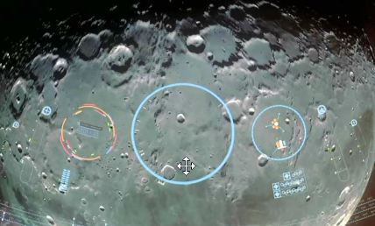
Big Picture
Prediction for deep learning infrastructure
Biometrics
Human Computer Interaction
Also applications out of this world…

Slide 155
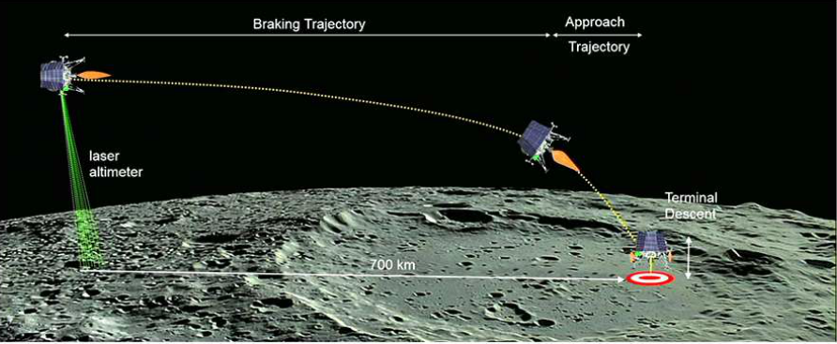
Big Picture
Fully autonomous moon landing for Lunar X Prize winning Team Indus

Slide 156
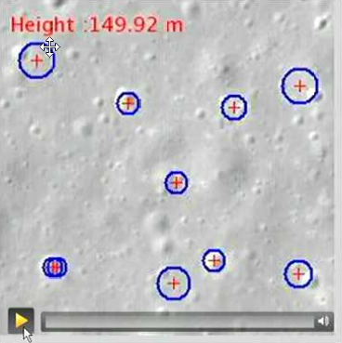
Big Picture
Fully autonomous moon landing

Slide 157
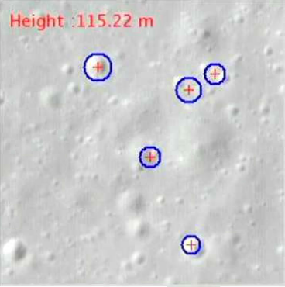
Big Picture
Fully autonomous moon landing

Slide 158
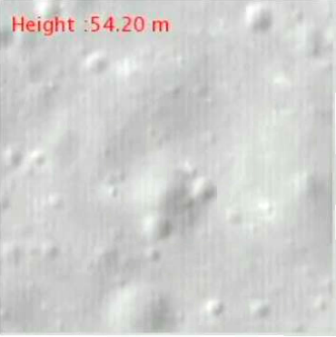
Big Picture
Fully autonomous moon landing

Slide 159
Bibliography
Krizhevsky, A., Sutskever, I., and Hinton, G. E. ImageNet classification with deep convolutional neural networks. In NIPS, pp. 1106–1114, 2012
Sermanet, P., Eigen, D., Zhang, X., Mathieu, M., Fergus, R., and LeCun, Y. OverFeat: Integrated Recognition, Localization and Detection using Convolutional Networks. In Proc. ICLR, 2014
Szegedy, C., Liu, W., Jia, Y., Sermanet, P., Reed, S., Anguelov, D., Erhan, D., Vanhoucke, V., and Rabinovich, A. Going deeper with convolutions. CoRR, abs/1409.4842, 2014

